Slide 1
Hazard Symbol
Presented By
Md Anisuzzaman Rana
Lecturer, Chemistry

Slide 2

Explosive
1.TNT, RCOOR

Slide 3

Flammable
1.CNG,LPG,

Slide 4

Oxidising
1.CHROMIC ACID, CHLORINE GAS

Slide 5

organic

Slide 6

Physical harmful

Slide 7

toxic

Slide 8

Environmental toxic

Slide 9

toxic

Slide 10

Ionic radiation

Slide 11

CORROSIVE

Slide 12
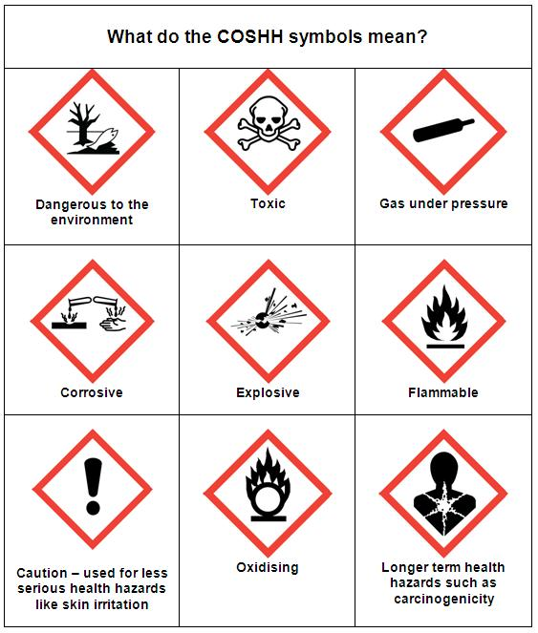
AT A GLANCE

Slide 13
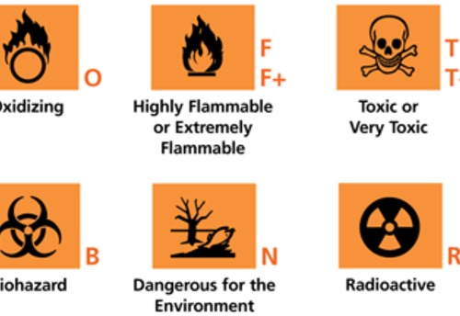
SYMBOLS

Slide 14

WHAT IS in below

Slide 15

electricity

Slide 16
T H A N K S

